Slide 1
Distributed Systems
Lecture 8 : SOA and Web Services

Slide 2
This Week
RMI, EJB and many other distributed computing frameworks suffer form many disadvantages.
This week we’ll look at Service Oriented Architecture which is an architecture proposed to solve many of these disadvantages
Also we’ll look at SOAP and REST as Web Service implementations

Slide 3
Issues with Traditional RPC
The RPC frameworks we have discussed so far share a few common issues that tend to inter-relate
  Tight coupling between client and server
  Security problems:
    Trust,
    Firewalls
    The Internet
  Limited/non-existent interoperability between frameworks

Slide 4
Issue: Coupling
Client and server in RPC are typically viewed as two parts in one (distributed) application
  Stubs/Skeletons are generated from the same IDL file / interface
  Marshalling/Serialization is technology dependent
  Implicitly creates a coupling between client and server

Slide 5
Issue: Trust and Firewall Security
Trust issues:
  The server shares it’s information with the client
  The client can compromise the server
Firewall security: The RPC frameworks advocate assigning each server component with its own port
  Follows good network protocol design - each different service has its own port (e.g. ftp = port 21, http = port 80)
  Firewalls are then configured to block access to dangerous/risky ports to minimise the risk of attacks

Slide 6
Issue: Internet Security
When the RPC is only internal to a corporate network, setup and security is less of an issue
  Physical + login security cuts out most attack vectors
But what if we must communicate over the Internet?
  Need to open a ‘hole’ in the firewall at the gateway, one hole for each server component inside the network
  Network administrators are very reluctant to do this!

Slide 7
Issue: Interoperability
Most RPC frameworks don’t interoperate with other frameworks
  Almost entirely down to incompatible communication protocols and message formats
    E.g. IIOP for CORBA vs. MSRPC for DCOM,
  Each protocol is tailored to the features of the framework it was designed for
  Presently, RPC became well-understood enough to define stable protocol and message format standards

Slide 8
Software Architectures
“The software architecture of a program or computing system is the structure or structures of the system, which include software components and the relationships among them.”
In other words, software architecture describes the system’s components and the way they interact at a high level.
Service-oriented architecture is a special kind of software architecture that has several unique characteristics

Slide 9
What is SOA?
Service-oriented architecture (SOA) is an architectural style where existing or new functionalities are grouped into atomic services.
SOA is commonly thought as an architecture that builds loosely coupled, interoperable, Standard based components called services.
They typically implement functionalities most humans would recognize as a service
  Filling out an online application for an account
  Viewing an online bank statement
  Placing an online book or airline ticket order.

Slide 10
What is SOA?
Service Orchestration
1
4
3
2
SOAP / XML
Authen-tication
Fund Transfer
Balance
Inquiry
Registration
Services

Slide 11
What is SOA?
They have no calls to each other embedded in them.
Instead of services embedding calls to each other in their source code, protocols are defined which describe how one or more services can talk to each other.
This architecture then relies on a business process expert to link and sequence services, in a process known as orchestration, to meet a new or existing business system requirement.

Slide 12
What is SOA?
Further in SOA, goal is to achieve “loose coupling” among interacting and contracted services via communication protocol.
An Internet-native distributed computing model
The term service-oriented means to support service’s dynamic description, publication, discovery, and use
  Web services have a very close definition

Slide 13
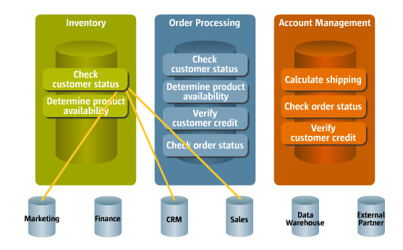
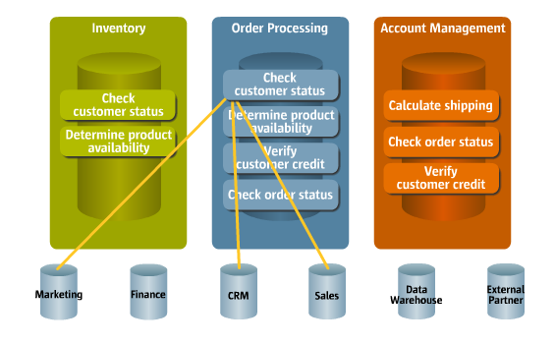
Traditional Distributed Systems
Functions are duplicated
Inventory Processing needs checking customer status
Order Processing also needs checking customer status

Slide 14
Traditional Distributed Systems
Low reusability
  If you try to reuse lot of cross references between sub-systems.
Adding a new function is difficult
  Develop everything from the beginning
Function inconsistency
  Development of “Checking customer status” can be different from sub-systems to sub-system.

Slide 15
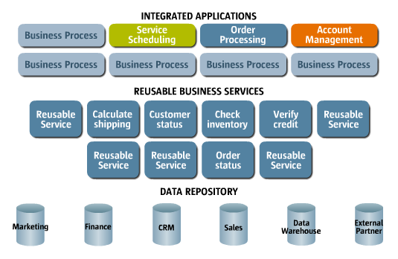
SOA Style
New ERP System is a reusable collection of services, that can be composed into Integrated Applications.

Slide 16
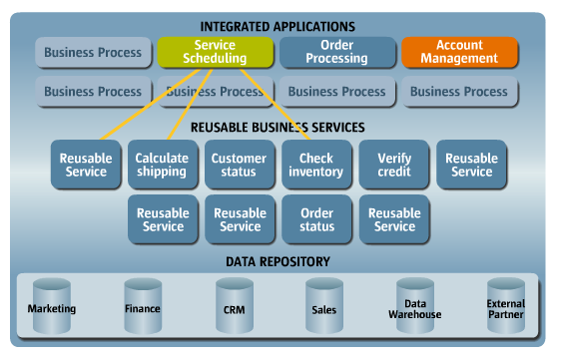
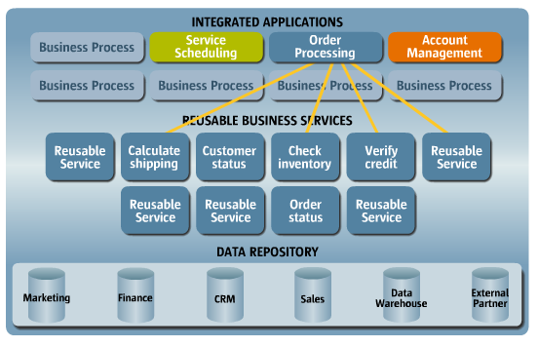
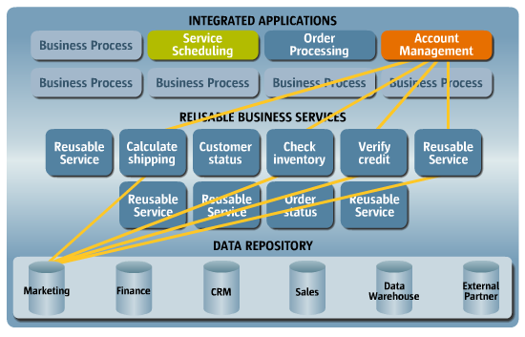
SOA Style
Service Scheduling Application
Order Processing Application
Management Report
Generation Application

Slide 17
SOA
What distinguishes SOA from other architectures is loosely coupling.
In loosely coupled systems the client of a service is essentially independent of the service.
The way a client communicate with the service is not dependent of the service implementation.
The client communicates with service according to a specified, well-defined interface.

Slide 18
What Happens in SOA?
Traditional
  Services and service processing logic is mixed up in the code.
SOA
  Try to separate business process and services
  Example : Data access layer detach the data management functionality out of application programs. Similarly we try to detach business process and the services.

Slide 19
Why SOA?
Accommodate rapid changes to the IT landscape in relation to the changes in the Business environments.
Promotes reuse of services across multiple business process automations.
Simple dynamic interfacing of services.
The services can be discovered and interfaces can be changed without major changes to applications.

Slide 20
Why SOA for Businesses
Manage CHANGE
Business
Processes
Change
Business
Processes
Change
Business
Processes
Business Applications
Change
Business Applications
Change
Business Applications
Business
Teams
Change
Business
Teams
Change
Business
Teams
Time

Slide 21
Characteristics of SOA
Loose Coupling - client can discover server’s supported protocols/formats and negotiate communication semantics
Reusable – similar to objected-orientation
Autonomous - runs independently of other systems
Stateless - no ongoing commitment between client & service
Composable - one service can contain another
Standards-based - interoperability among SOA services
Contract-based – i.e. uses interfaces
Fine-grained - services should be small (higher cohesion)
  Reusable, modular - another way of saying ‘fine-grained’
Encapsulation - information hiding
Heterogeneous – technologies, platforms, applications, etc.
Location transparent

Slide 22
Implementing SOA
SOA can be implemented using many technologies:
  Web services
  RPC
    CORBA
    DCOM
  SOAP
  WCF (Windows Communication Foundations) Part of .NET framework.
  REST (Web API)

Slide 23
Where to Use SOA?
SOA is most useful for what it was designed for:
  When crossing platform boundaries
  When crossing trust boundaries
Business logic that change frequently and highly reusable is more eligible for SOA.
  E.g. Payment requests, Balance inquiries

Slide 24
Where NOT to Use SOA
SOA isn’t applicable everywhere. It’s poor for:
  Non-distributed applications
  Applications with a short deployed lifetime
  Asynchronous communication between servers
  Interactive GUI applications
  A homogenous application environment

Slide 25
A Web Service
● A service that is accessible over a web protocol
● Well defined interface - protocols define the interaction
between the client and the server

Slide 26
Why Web Services?
● A Service accessible over a web URL!
○ Reusable functionality
○ Business to business integration
○ Information sharing
○ Business process automation
● Innovation - offer different services

Slide 27
What will you learn?
● Service Invocation
Perform Web
Service Invocation

Slide 28
Hands-on
1 - Go to http://openweathermap.org/
2 - Read the documentation
3 - Signup and get a key
4 - Try to read weather by giving longitude and latitude http://api.openweathermap.org/data/2.5/weather?lat=35&
lon=139&APPID=your_key
5 - Try to read weather in Colombo

Slide 29
Web Services Everywhere!
● Grid computing
○ SETI@home
● Cloud computing
○ IaaS - AWS
○ SaaS APIs - Salesforce APIs, Netsuite APIs, PeopleHR API
● Google Maps APIs

Slide 30
Web Services & SOAP

Slide 31
SOAP
What does it stand for?
● Simple Object Access Protocol
What is it?
● Two versions - SOAP 1.1 and SOAP 1.2
● SOAP 1.2 became a W3C recommendation in 2003
Who/where/when?
● Initiated by IBM, Microsoft

Slide 32
SOAP Basics
● Relies on XML and defines a message structure
● Can run on any protocol HTTP, SMTP
Envelope
Header
Body

Slide 33
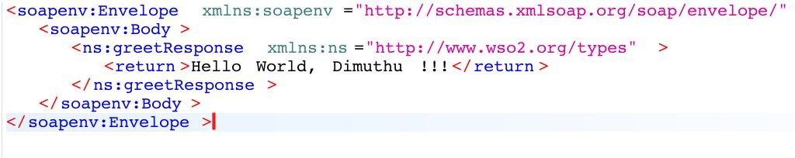
Sample SOAP Message

Slide 34
SOAP Engine
SOAP Engine ^{Java Class}
C# Class

Slide 35
WSDL
● Web Service Description Language - WSDL1.1 & 2.0
● Describes a web service using XML
○ Uses XML Schema
○ Input message
○ Output message
○ Transports
○ Versions

Slide 36
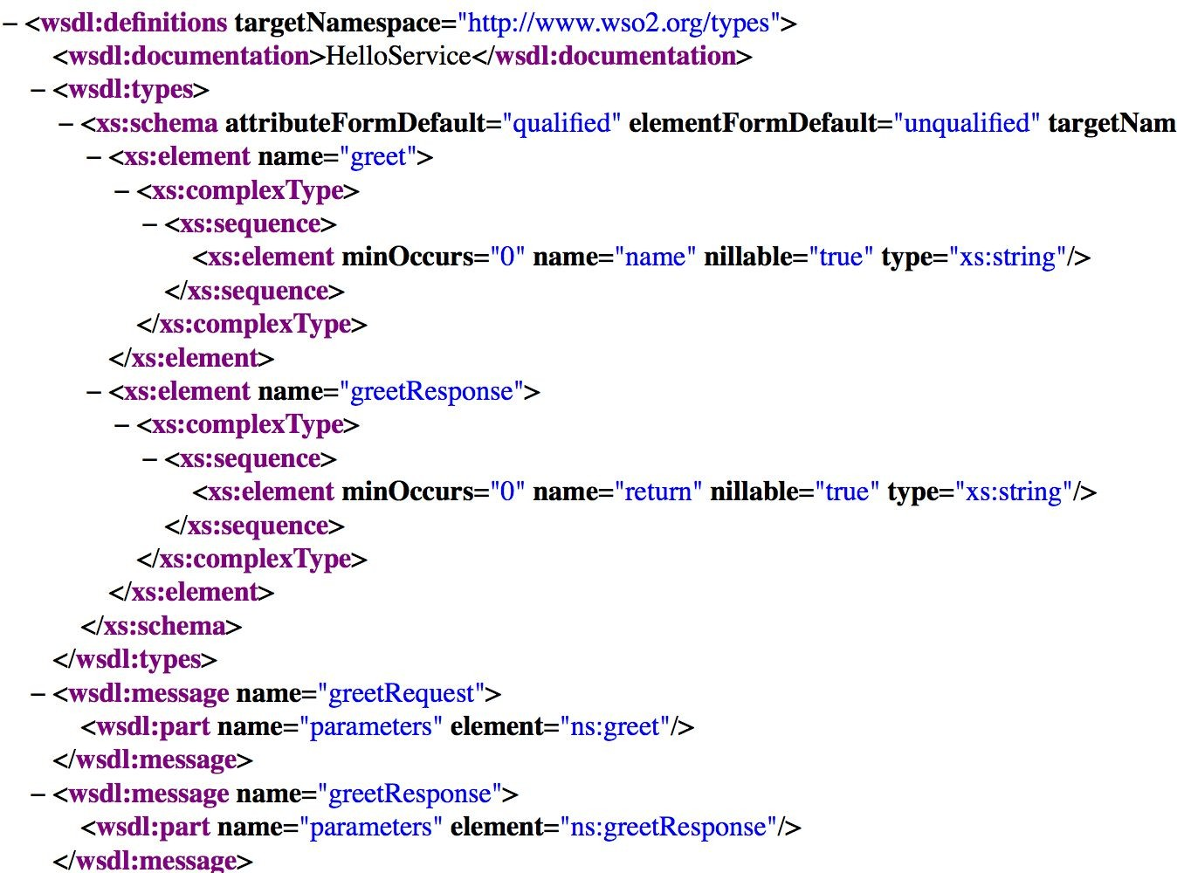
SOAP and WSDL - A strong marriage

Slide 37
What will you learn?
● Service Invocation
● Self contained
functionality
● Service interface
Perform SOAP Service Invocation

Slide 38
WS* Specifications
● WSDL 2.0
● WS Security
● WS Addressing
● WS Policy
● WS Trust

Slide 39
REST

Slide 40
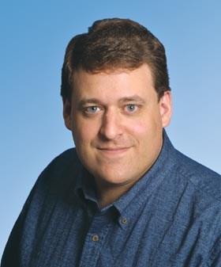
REST
What does it stand for?
● REpresentational State Transfer
What is it?
● Architectural pattern - not a standard
Who/where/when?
● Roy Fielding in 2001

Slide 41
REST Principle
How?
HTTP
Data
Students,
Employees
What?
XML,
JSON
Where?
URI

Slide 42
Stateless
● No state stored on the server
● Every HTTP request executes in complete isolation
● Simpler to design and evolve
● Easier to scale

Slide 43
REST - Methods
● Defines the action taken with a URL
● Proper RESTful services expose all four
HTTP
Method
Action
Example
POST
Create
http://wso2.com/general/dbusers/user/
GET
Read
http://wso2.com/general/dbusers/users http://wso2.com/general/dbusers/user/sam
PUT
Update or
Create
http://wso2.com/general/dbusers/user/sam
DELETE
Delete
http://wso2.com/general/dbusers/user/sam

Slide 44
URIs - Addressability
● Name, address and version of resource
● Self-descriptive
● Unique URIs are exposed for every resource from
RESTful system
○ URI per resource
● URIs are discoverable by clients

Slide 45
Data Representation
● Can be
○ XML, JSON, HTML
● Content negotiation based on HTTP headers
○ Accept or Content-Type
● Query parameters
○ GET /v1/employees/123?format=json
● URI exention
○ GET /v1/employees/123.xml

Slide 46
An Example REST
● In http://ip-api.com/json/[ip_address] service
● Get the location of an Ip Address
● Content type - Application/JSON
● Send HTTP GET

Slide 47
REST Implementation

Slide 48
REST - Interface Description
● Swagger- Also known as OpenAPI specification
○ Interface description language for describing,
producing, consuming and visualizing RESTful web
services
● JSON based
● Allows both humans and machines to understand
● Goal - Update client and documentation at the same
time as the server

Slide 49
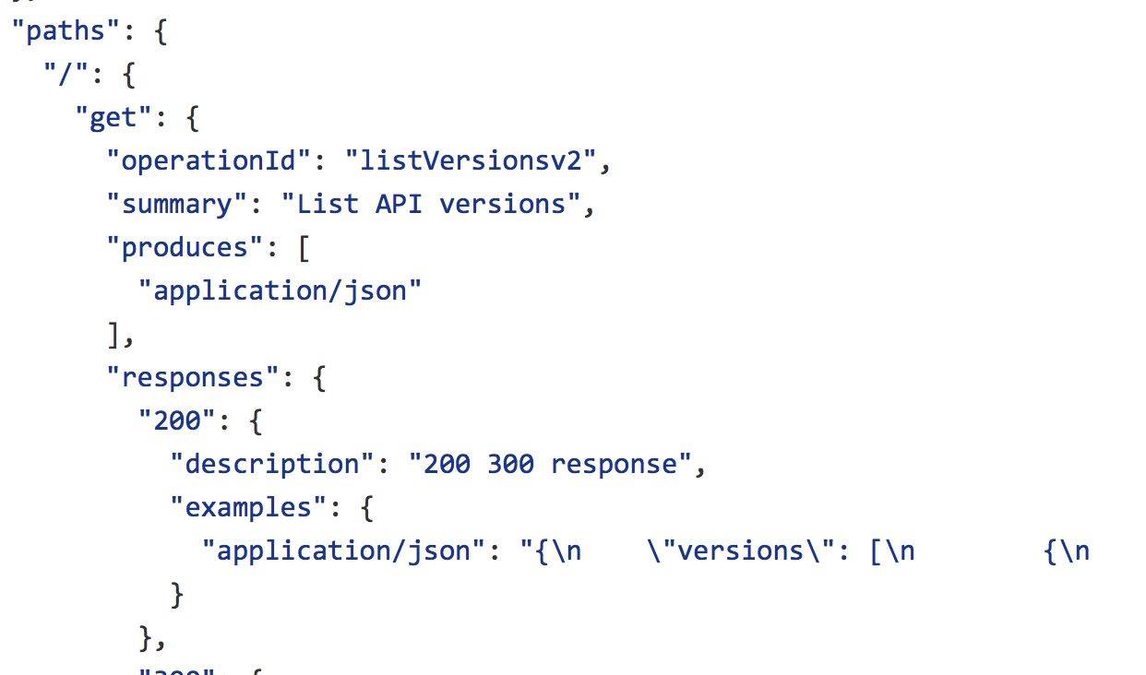
Swagger

Slide 50
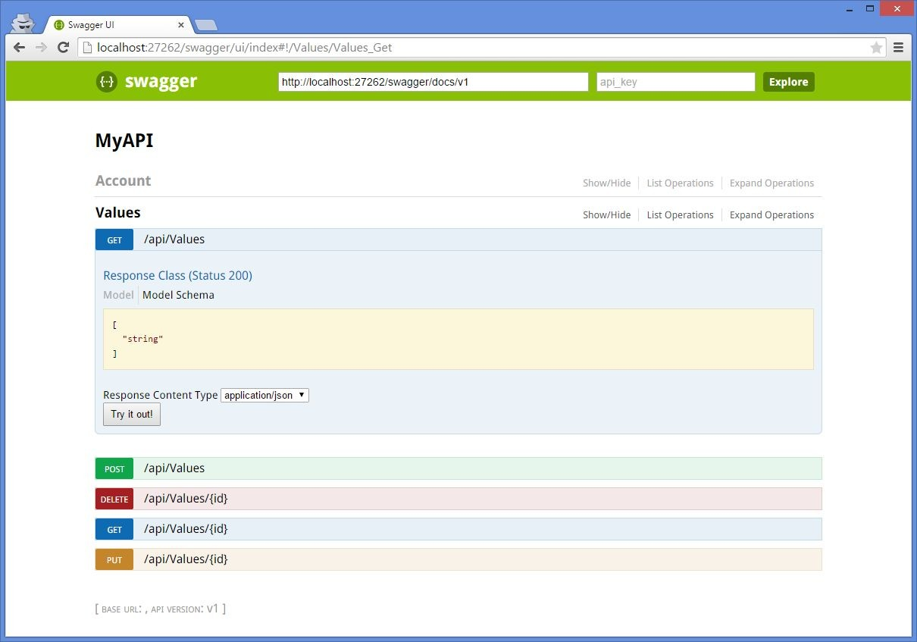
Swagger
!

Slide 51
Web APIs

Slide 52
Web APIs
What is it?
● Not a standard. Not an architecture pattern. Just a
“term”.
● Concentrating on the accessibility of services.
○ Secured (access controlled), open and monitored
services
● A business capability delivered over the Internet to
internal/external consumers
API = Service + Security + Documentation

Slide 53
Consuming REST Services - AJAX

Slide 54
Ajax
Ajax stands for Asynchronous JavaScript And XML
  Convergence of a few disparate technologies that together facilitate rich Web browser GUIs via client-side scripting
    Term ‘Ajax’ was coined to describe their use together
  JavaScript: scripting language (ie: interpreted on the fly at run-time) for client-side processing in Web browsers
  Asynchronous: Built-in browser support for sending arbitrary messages asynchronously to a server via JavaScript
  XML: General-purpose data document format; Web browsers have built-in XML parsers for rendering HTML

Slide 55
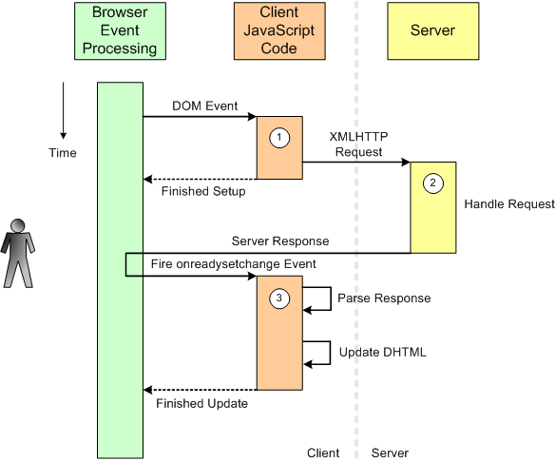
Ajax Sequence Diagram

Slide 56
XMLHttpRequest Class
Methods of XMLHttpRequest object:
    open - sets the URL for submitting (sending) the request to
    setRequestHeader - Add/set headers, usually just Content-Type
    send - accepts the text of the message contents and sends it
Properties of XMLHttpRequest object:
    onreadystatechange - pointer to completion callback function. Called every time the readyState changes. Note: lower case!
    readyState - Callback state (see previous slide)
    status - Call success/failure (200=success, others are error codes)
    responseText - Raw message text from server
    responseXML - XML parser object attached to responseText

Slide 57
Ajax + Web Service Example (SOAP 1.2)
function AddRPCAsync_SOAP12(onCompletionFn) {
req = null;
if (window.XMLHttpRequest != undefined)
req = new XMLHttpRequest(); ← Firefox and compatible
else
req = new ActiveXObject("Microsoft.XMLHTTP"); ← Internet Explorer
req.onreadystatechange = onCompletionFn;
req.open("POST", "http://localhost/WebServices/Calculator.asmx", true); ← No .asxm/Add here!
req.setRequestHeader("Content-Type", "application/soap+xml"); ← Set up header(s)
req.send("<?xml version=\"1.0\" encoding=\"utf-8\"?> \
<soap12:Envelope xmlns:xsi=\"http://www.w3.org/2001/XMLSchema-instance\"
xmlns:xsd=\"http://www.w3.org/2001/XMLSchema\"
xmlns:soap12=\"http://www.w3.org/2003/05/soap-envelope\"> \
<soap12:Body> \
<Add xmlns=\"http://www.curtin.edu.au/SPD361/\"> \
<operand1>8</operand1> \
<operand2>4</operand2> \
</Add> \
</soap12:Body> \
</soap12:Envelope>");
}
function AddRPC_SOAP_OnCompletion() { ← Same as SOAP 1.1
if (req.readyState == 4) {
if (req.status == 200) {
var ndResult = req.responseXML.documentElement.getElementsByTagName("AddResult")[0];
alert(ndResult.childNodes[0].nodeValue); ← Access result (<AddResponse>) via DOM
}
else
alert(”Asynchronous call failed. ResponseText was:\n" + req.responseText);
req = null;
}

Slide 58
Calling a REST services with AJAX + JQUERY
$.ajax({
type: "GET",
dataType: "jsonp",
url: "http://localhost:8080/restws/json/product/get",
success: function(data){
alert(data);
}
error: function(data);
alert(‘error’);
});

Slide 59
AJAX in JQuery
$.get(url [, data] [, success(data,textStatus, jqXHR){} )
$.post(url [, data] [, success(data,textStatus, jqXHR){} )
$.getJSON(url [, data] [, success(data,textStatus, jqXHR){} )
  Use an AJAX get request to get JSON data
$.get( "ajax/test.html", function( data ) {
$( ".result" ).html( data );
alert( "Load was performed." );
});
$.post( "ajax/test.html", postdata, function( data ) {
$( ".result" ).html( data );
});

Slide 60
REST and SOAP Implement SOA

Slide 61
Summary
● Service Oriented Architecture
● Web Services
● REST
● APIs & Micro services

Slide 62
Many technologies for
implementing a SOA.
None is perfect.
All achieve data sharing,
modularity, agility, reuse and
innovation!
Reuse

Slide 63
Questions?

